Slide 1
Predicting the likelihood of stroke occurrence based on patient demographic and health-related variables.
Machine Learning presentation by:
SMALLMAN JIMU
Department of Data Science

Slide 2
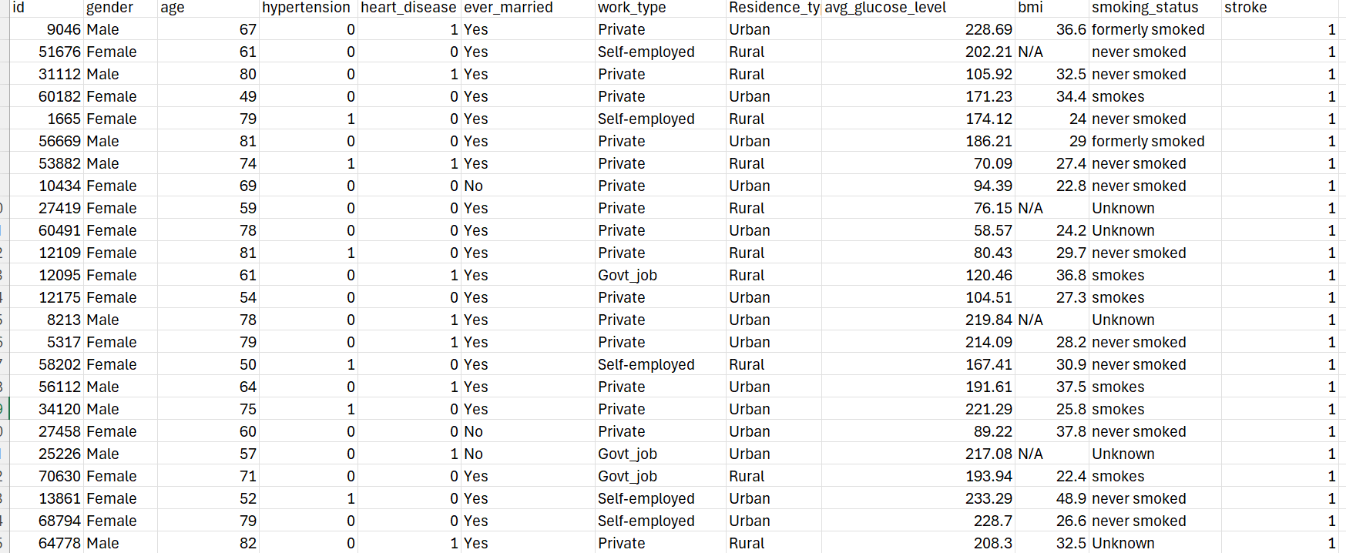
Check snippet of dataset

Slide 3

Objective of Presentation
Objective 1: Predicting the likelihood of stroke occurrence based on model selection, demographic and health-related variables.
Objective 2: Using features like age, gender, hypertension, heart disease, smoking status, and other medical history data, the goal is to to predict whether a patient is at risk of experiencing a stroke (binary classification: Stroke or No Stroke).
Why This Problem is Relevant
By identifying which variables strongly influence stroke risk, healthcare providers can focus on targeted prevention strategies.
Strokes are one of the leading causes of death globally, and early risk detection can help save lives.

Slide 4
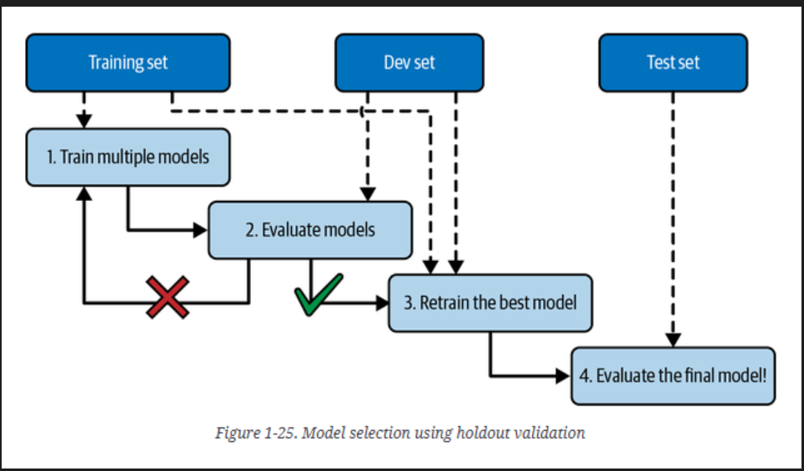
Approaches for Prediction
HYPERPARAMETER TUNING
Preprocessing the Data:
Handle missing values and encode categorical variables (e.g., gender, smoking status).
Normalize numerical features like age or glucose levels.
Dataset was 5082 rows in total, Perform a train test split
Removal of Null values
Link : https://www.kaggle.com/datasets/fedesoriano/stroke-prediction-dataset
Model Training
Set Hyperparameters for the models and defining the model, Creating Pipelines and Hyperparameter Grids
Apply classification algorithms like Logistic Regression, Random Forest, SVC and Decision Tree getting the best models
Evaluate the model using metrics like accuracy, precision, recall, and F1-score.
The best hyperparameter was Logistic Regression as proven in the code I its overall
Insights:
Feature importance analysis to determine which factors (e.g., smoking, age, or glucose levels) are most critical for predicting stroke risk.
Exploratory Data Analysis (EDA)
Correlation Matrix

Slide 5
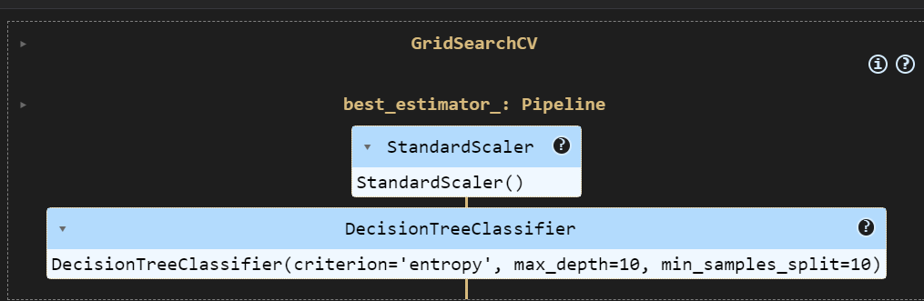
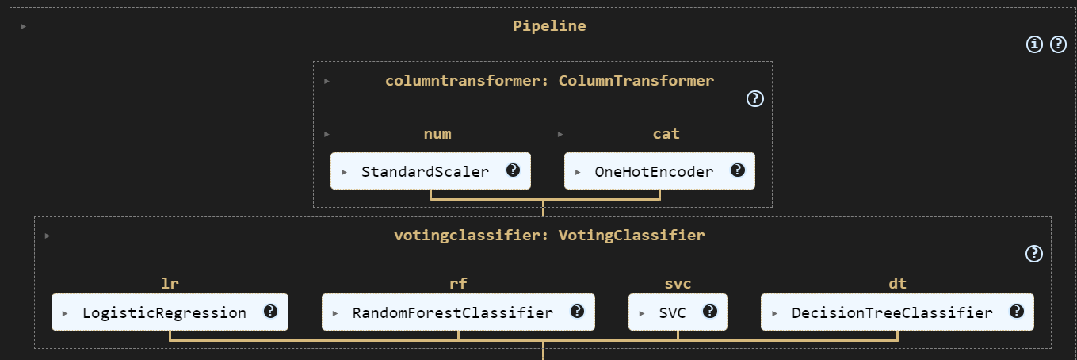
Grid search And Creation of a Pipeline using the 4 Models Logistic Regression , Random Forest , SVC and Decision Tree Classifier

Slide 6
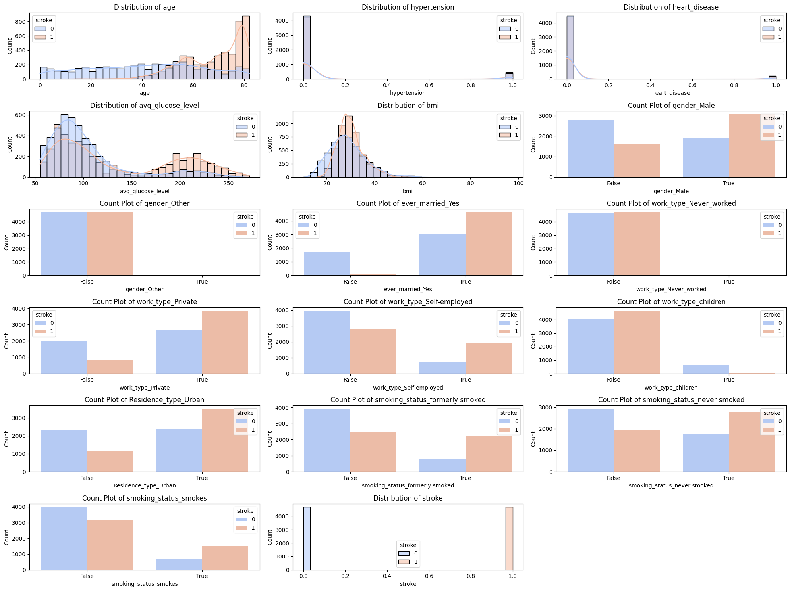
Exploratory Data Analysis

Slide 7
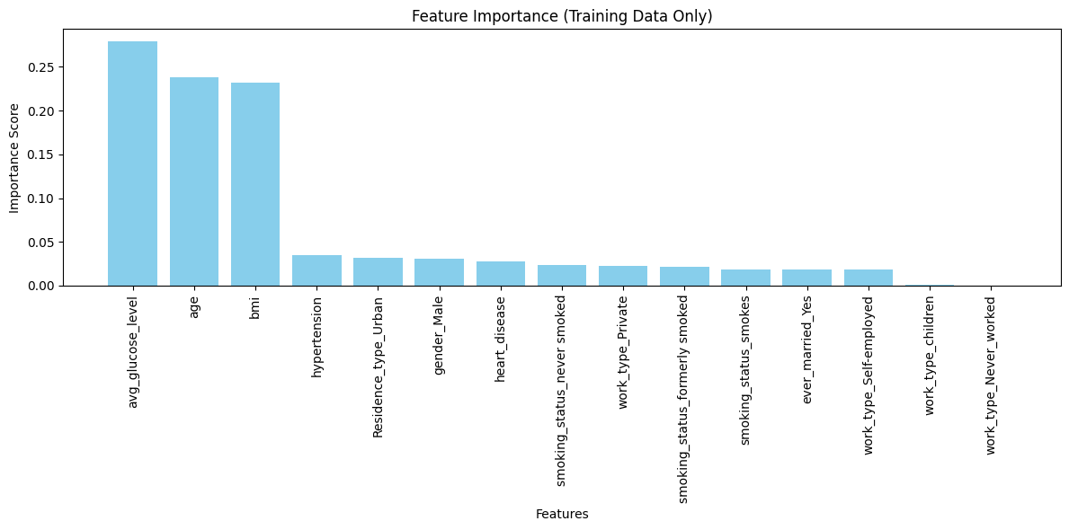
Feature importance

Slide 8
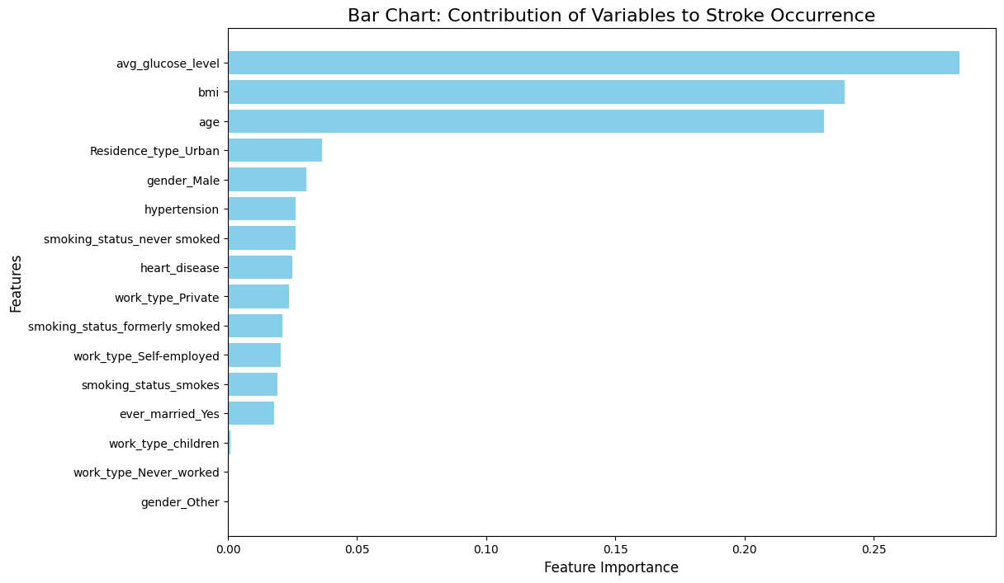
Shown by the bar chart on my right indicates the contribution of each variable to stroke occurrence and shows that
According to the bar chart Avg glucose level has the highest contribution over 0.25
Bmi is the second Highest with 0.23
Age is the third Highest with 0.21
# ID was filtered out because it has no impact on this that’s why it was not inlcuded

Slide 9
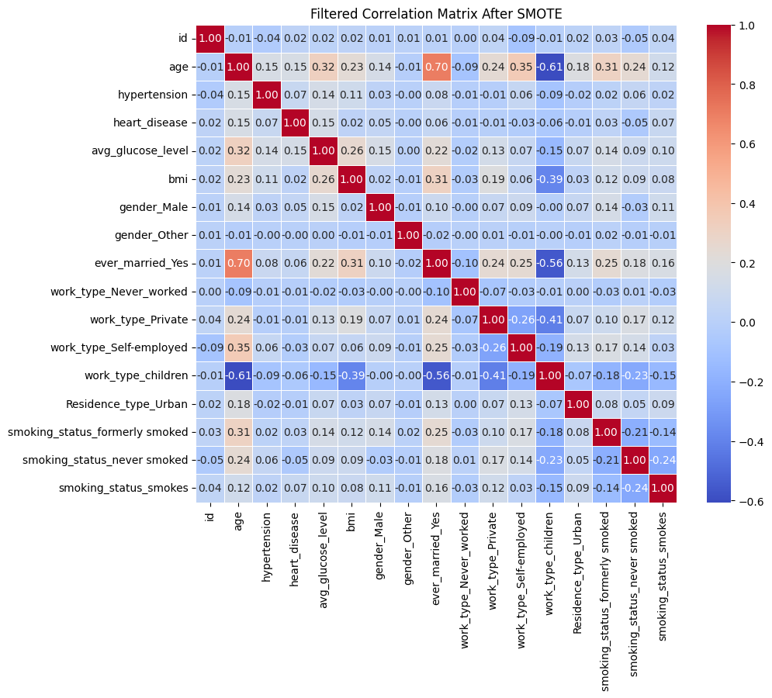
Correlation matrix of variables

Slide 10
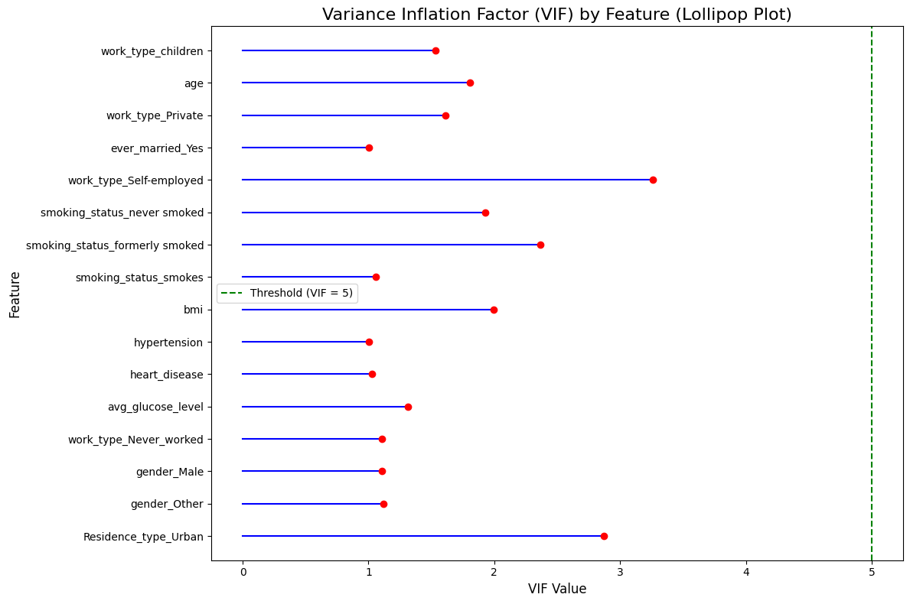
A Multicollinearity Test
Explanation
A lollipop plot showing the variance of each variable and as shown it can be depicted that it is below the threshold of 5 which shows that all the variables are okay since they do NOT EXCEED 5
The plot will now display each feature’s VIF value as a red dot connected to the baseline by a blue stem, along with a dashed green line for the VIF threshold of 5.

Slide 11
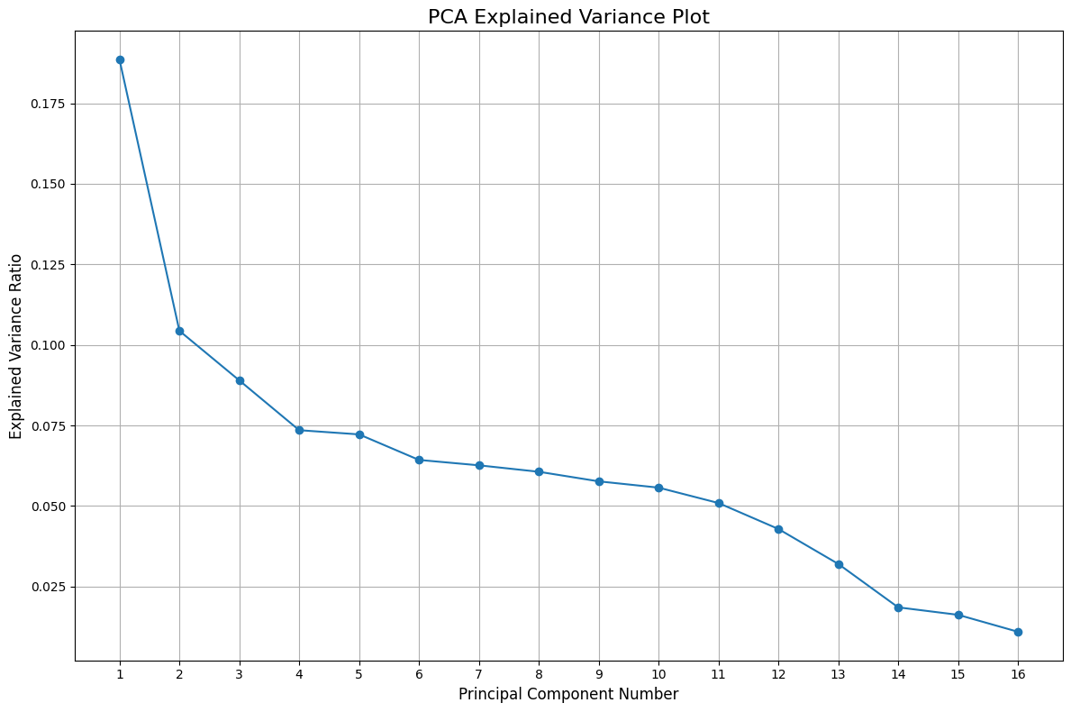
The explanation of PCA components and elbow
The table explains how the first 4 PCA components chosen contain about 75% of the dataset contributing the most, that is why we Picked 4 and the rest 5 and going onwards contribute lesser
Elbow Point: The plot shows an "elbow" curve, which indicates a point where adding more components provides diminishing returns in terms of explained variance. And this case its 4
Age: Likely contributes strongly, as it’s a major factor in stroke likelihood.
Avg_glucose_level: Blood glucose levels significantly relate to stroke occurrences.
Smoking status (e.g., "smokes", "formerly smoked"): This can explain some variability in health risks
BMI (if present in the dataset): High BMI can contribute to health risks.
Heart disease: Presence or absence of heart disease is another critical variable.

Slide 12
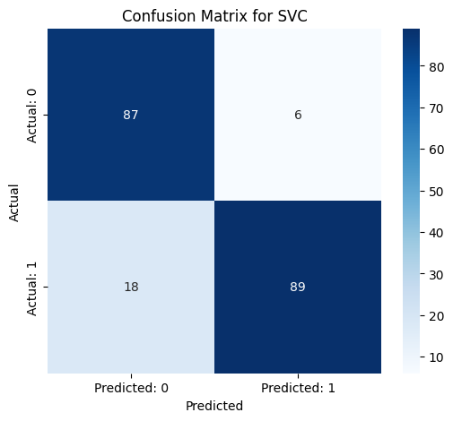
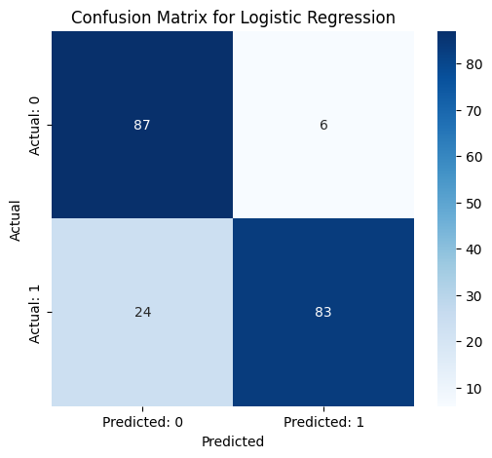
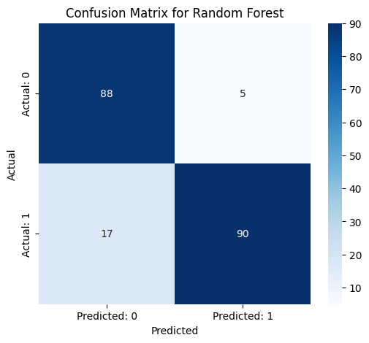
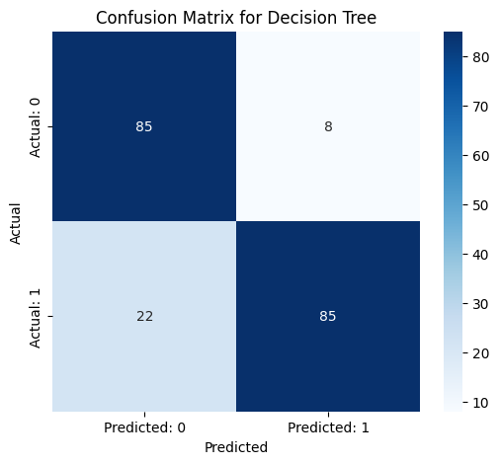
Interpretation of the Results above According to the above results it can be denoted that SVM , Decision Tree and Random Forest provide the best Accuracy with the highest which is 0.89 For Randon Forest whilst Logistic Regression appears to be the least predictor in all evaluations form accuracy to F1 score so because of this Random Forest is the best in all categories then followed by SVC model so in terms of selecting the Random Forest is the best model All listed features—age, hypertension, avg_glucose_level, and smoking_status_smokes—are positively associated with the dependent variable. Additionally, their P-values fall below 0.05, confirming their statistical significance. These findings suggest that these features are important predictors in the model. Age stands out as the most influential variable given its high coefficient. Let me know if you'd like to delve deeper into this analysis or explore visual representations! Below are confusion Matrices for the models evaluated
MODEL EVALUATION
LOGISTIC REGRESSION TABLE
MODEL | ACCURACY | PRECISION | RECALL | F1 SCORE
Logistic regression | 0.85 | 0.93 | 0.78 | 0.85
SVC | 0.88 | 0.94 | 0.83 | 0.88
Random Forest | 0.89 | 0.95 | 0.84 | 0.89
Decision Tree | 0.88 | 0.93 | 0.83 | 0.88
Feature | Coefficient | P-value | Significant (P < 0.05)
age | 1.657199 | 5.343316e-31 | True
hypertension | 0.151602 | 2.710626e-03 | True
avg_glucose_level | 0.206621 | 3.243830e-04 | True
smoking_status_smokes | 0.210481 | 2.701555e-02 | True

Slide 13
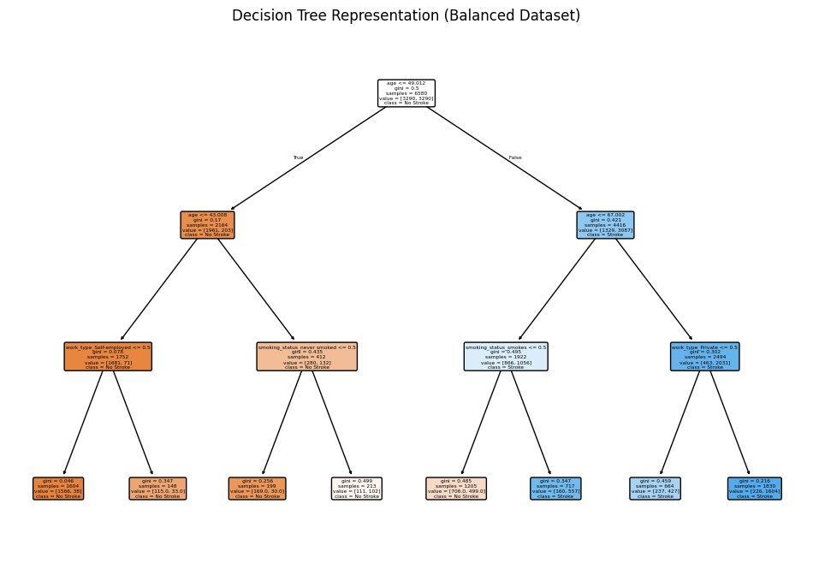
Root Node: The decision tree starts with the condition age <= 0.012, dividing the dataset into two primary branches based on this criterion. This node has a Gini value of 0.5, indicating maximum impurity, and evenly split samples.
Overall, the tree highlights the most important features influencing stroke occurrence, with variables like age, work type, and smoking status playing key roles. The structure gives insight into how decisions are made, and the data is categorized. If you'd like, I can help you interpret specific sections of the tree in more detail!

Slide 14

CHALLENGES AND SOLUTIONS
CHALLENGES
Imbalanced Data: The dataset had fewer positive stroke cases, impacting model learning.
Limited Feature Set: Some relevant medical history or lifestyle variables were missing.
Overfitting Risks: Complex models like Random Forest and Decision Tree require tuning to avoid
overfitting.
POSSIBLE SOLUTIONS
Use of class-weighted models to assign higher weights to minority class during model training.
Expand dataset by integrating electronic health records (EHRs), survey data, or wearable device data.
Cross-validation (e.g., k-fold) to ensure generalization
Use SHAP (Shapley Additive explanations) or LIME to explain individual predictions.

Slide 15
ACKNOWLEDGEMENT
MICHEAL GILBERT

